Slide 1
WELCOME
Class: B.Com – Part-1
Subject: Financial Accounting
TOPIC: Branch Accounts – Part - 2
Prepared By
Dr. SHAHID IQBAL
Guest Faculty
Marwari College, Darbhanga,
Mobile No. and Whatsup No. : 7004160257
Email ID: shahidlnmu@gmail.com

Slide 2
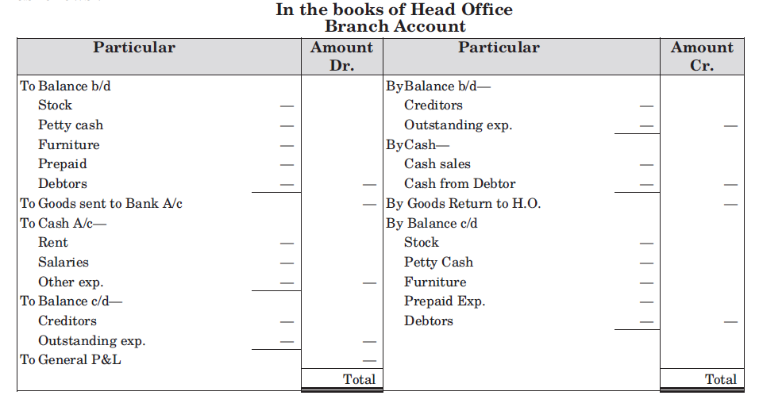
Branch Account in the books of Head Office:
If branch account is to be prepared on the basis of above mentioned entries, it will appear as follows:

Slide 3
Illustration 1.
Hindustan Ltd. has a branch at Bhopal. Branch has to remit daily cash receipts to the head office and all expenses of the branch are paid by the Head Office directly. Following are the transactions between Head office and branch for the year ended 31st March, 2016 :
Stock at Branch on 1 Aril 2015 6,000
Goods supplied to Branch during the year 1,20,000
Cash sent to Branch for :
Rent 1,100
Salaries 9,000
Insurance 300
Goods returned by branch 3,000
Cash sent to Branch for Petty expenses 500
Cash received from the branch during the year 1,20,000
Cash sent by branch on 29 March 2016 5,000
Stock at Branch on 31st March 2016 10,000
Balance of Petty Cash on 31st March 2016 50
Outstanding Rent on 31st March 2016 100
Give Journal entries and show the Branch Account in the books of Head Office.

Slide 4
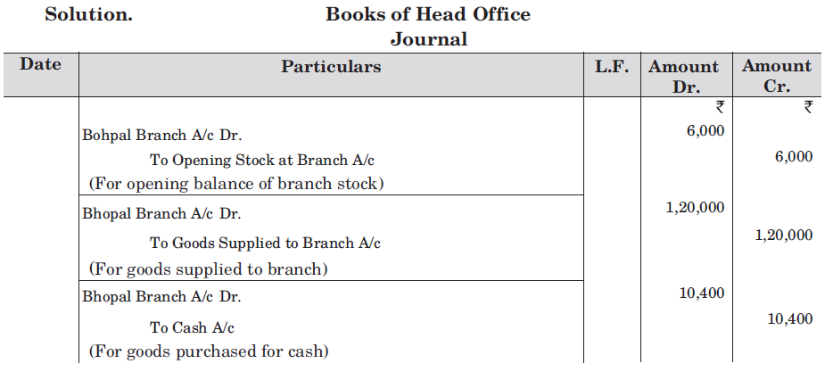
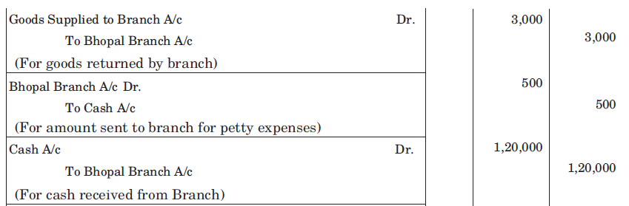

Slide 5
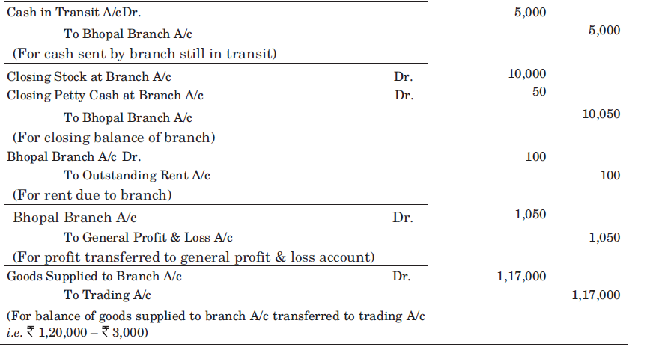

Slide 6
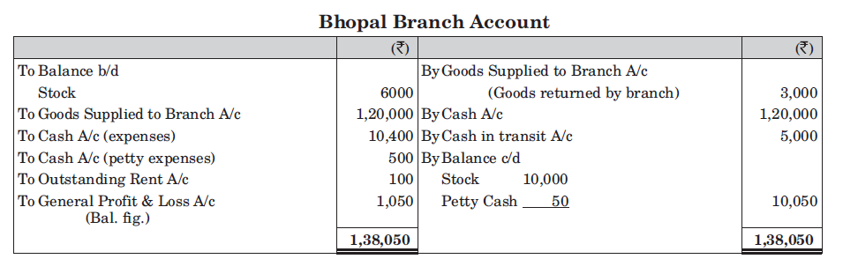

Slide 7
Thank You

